Slide 1
MATERIALIZED VIEWS IN HP PORTAL
HP Optimization.

Slide 2
Contents
What is a View ?
What is a Materialized View ?
Defining Materialized Views …
Querying as 1 to 1 View/Table ?
Real life examples based on HP MSC …∞

Slide 3
a View
Virtual table(a)/aggregation(s) -> dynamic
Behavior:
Actually, when MSSQL execute the view it replaces the view name with the actual select statement that is the definition of the view.
Execution plan then… ?

Slide 4
a Materialized View
First introduction in Oracle DBs (Materialized View)
Data warehousing use -> snapshot-ware
Then came IBMs DB2 (Materialized Query Tables)
Behavior similar to Oracle
At least since 2k MS SQL (Indexed Views)
Index storing -> aggregations, pre-joins etc

Slide 5
Definition of M-View
CREATE VIEW [xyz].[vwQWE] WITH SCHEMABINDING
AS
Pros and Cons of SCHEMABINDING
USE OF “WITH (NOEXPAND)”
1 to 1 map -> ordinary table
M-Views and Tables in execution plans

Slide 6
Examples
DEF -> let’s start definitions

Slide 7
Examples
DBCC FREEPROCCACHE
DBCC DROPCLEANBUFFERS
SET STATISTICS TIME ON
SELECT *
FROM HPPortal.dbo.tblPartnerProfile
WHERE CompNum = 10010220
SET STATISTICS TIME OFF
GO
DBCC FREEPROCCACHE
DBCC DROPCLEANBUFFERS
SET STATISTICS TIME ON
SELECT *
FROM HPPortal.hpmsc.vwMAT_VIEW_EXtblPartnerProfile WITH (NOEXPAND)
WHERE CompNum = 10010220
SET STATISTICS TIME OFF

Slide 8
Execution times

Slide 9
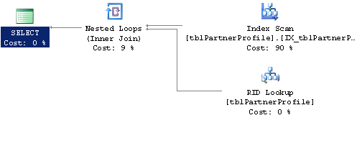
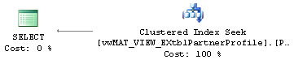
Examples – Execution Plans

